Slide 1
Using Machine Learning in Smart Survey
Scanning Supermarket Receipts for the Budget Survey
Chris Lam, Tim de Jong, Marco Puts, Vera Toepoel
Statistics Netherlands
MASS-workshop, London, June 5th, 2025

Slide 2
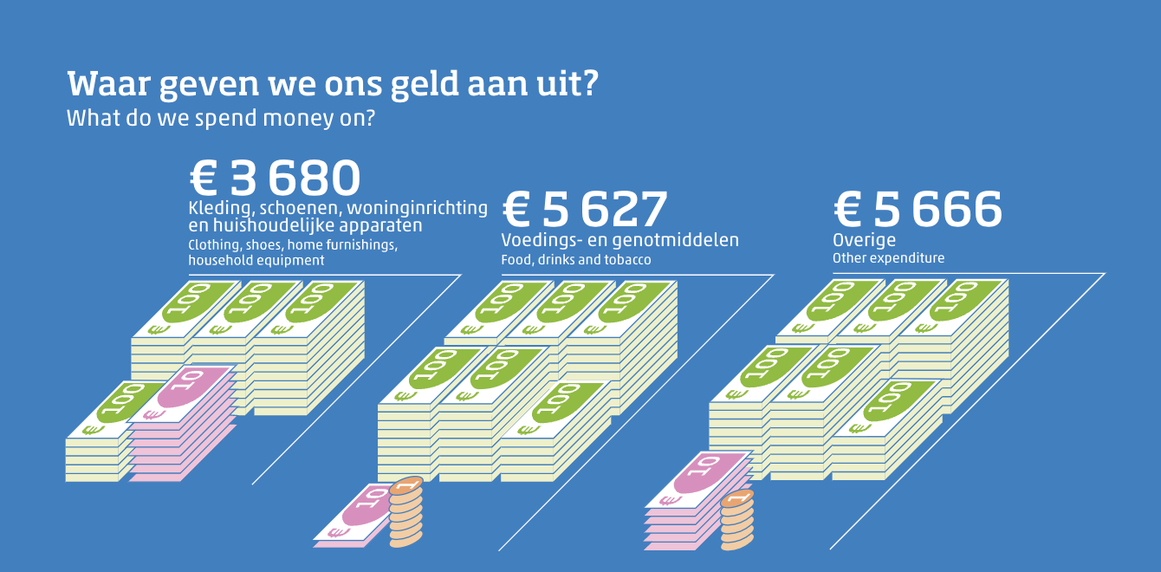
Household budget survey
Notes:
Every four years, statistics netherlands conducts a budget survey: how does the dutch population spend their money.

Slide 3
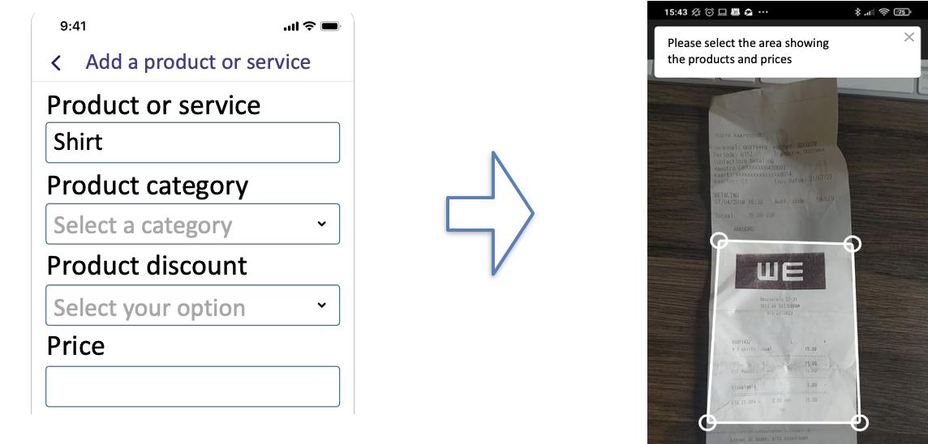
Response is burdensome…
Notes:
The survey requires respondents to fill in a survey. But this can be quite burdensome when many products needs to be entered.

Slide 4
Response is burdensome…
Notes:
To combat this reponse burden, we wanted to introduce a functionality allowing respondents to scan their purchase receipts.

Slide 5
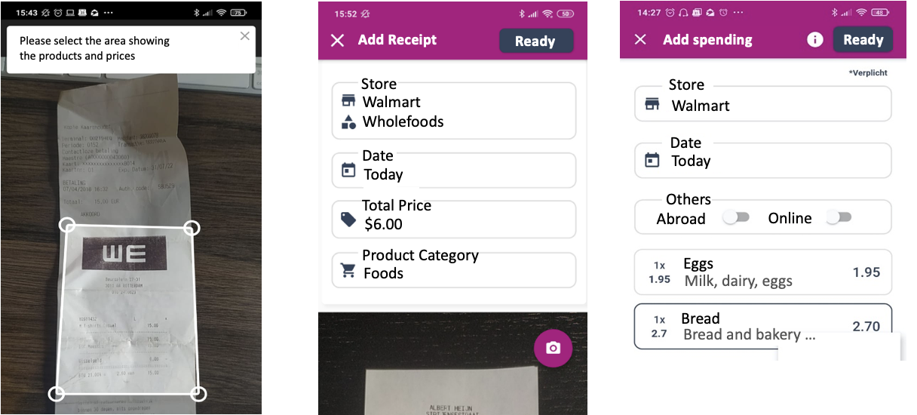
Response is burdensome…
Notes:
once the receipt is scanned, the idea is that the relevant information is extracted from the receipt and then automatically filled in in the survey.
The respondent then only has to check the data and then submit it to us.

Slide 6
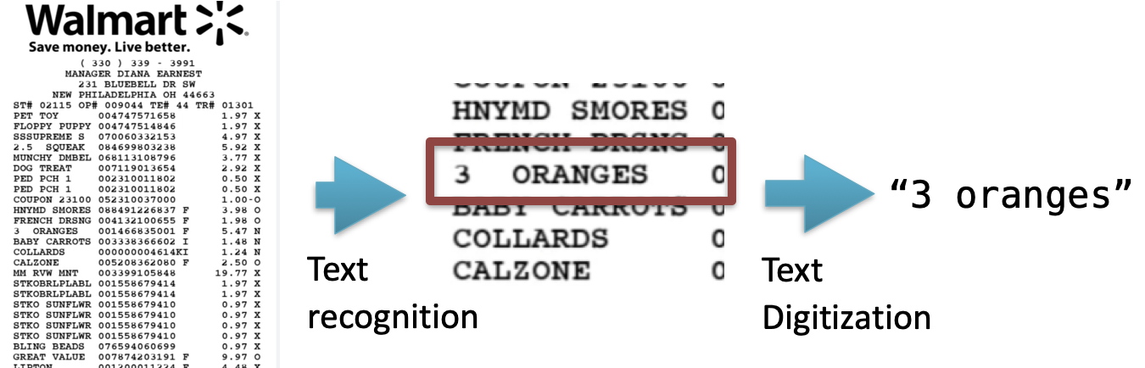
Receipt Scanning
Notes:
if we take a look at what is needed to implement this functionality, we would need to implement three steps:
Text recogintion
Text digitzation

Slide 7
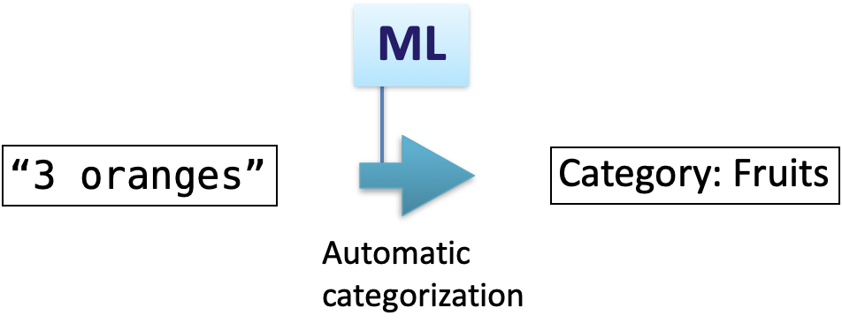
Focus: Product text classification
Notes:
And then finally the classification of a product so that we can actually analyze the submitted data.
The focus of this paper is on this part of the receipt scanning functionality: the classification of products

Slide 8
Focus: Product text classification
Notes:
And in particular with ML.

Slide 9
Focus: Product text classification
Product text | Product category
Eggs | ???
Strawberries | ???
Coca cola | ???
… | …
Notes:
And in particular with ML.

Slide 10
Focus: Product text classification
Product text | Product category
Eggs | 011480: Eggs
Strawberries | 011645: Strawberries
Coca cola | 012600: Soft drinks
… | …
Notes:
And in particular with ML.

Slide 11
Is the ML classifier good enough
for in a smart survey?

Slide 12



Research questions
Robustness over Time: How well does ML classify over time?
$≤$Jan.
Feb.
Mar.
$≤$Jan.
Feb.
$≤$Jan.
Time

Slide 13
Research questions
Robustness over Time: How well does ML classify over time?
Generalizability across stores: Do ML models generalize across supermarkets?
Store A
Store B

Slide 14
Data for cross validation
Scanner data
Records of products sold in each week
3 stores: Lidl, Albert Heijn, Plus
Unfortunately, no real data scanned from receipts!
Product text | Product category | Store | Revenue | Date
Eggs | 011480: Eggs | Lidl | €2.020.034 | 1-1-2025
Strawberries | 011645: Strawberries | Lidl | €1.052.582 | 1-1-2025
Coca cola | 012600: Soft drinks | AH | €20.052.285 | 14-1-2025
… | … |  |  | …
Notes:
Of course, for ML you would need existing data to train a model.
The data that we were given were got is scanner data from three major supermarkets in NL.

Slide 15
Experiments
Two Cross validation strategies on Scanner data
  Robustness by time: Split by date
Scanner data
< June 2023
(n=445,468)
June 2023
(n=73,113)
July 2023
(n=88,741)
July 2023
(n=74,248)
Training set
Test set 1
Test set 2
Test set 3

Slide 16
Experiments
Two Cross validation strategies on Scanner data
  Robustness over time: Split by date
  Generalizability stores: Leave-out one supermarket
Scanner data
Albert Heijn
(n=26,196)
Lidl
(n=25,719)
Plus
(n=451,227)

Slide 17
Experiments
Two Cross validation strategies on Scanner data
  Robustness over time: Split by date
  Generalizability stores: Leave-out one supermarket
Scanner data
Albert Heijn
(n=26,196)
Lidl
(n=25,719)
Plus
(n=451,227)

Slide 18
Experiments
Two Cross validation strategies on Scanner data
  Robustness over time: Split by date
  Generalizability stores: Leave-out one supermarket
Scanner data
Albert Heijn
(n=26,196)
Lidl
(n=25,719)
Plus
(n=451,227)

Slide 19
Results: Robustness over Time
Notes:
0.5 drop in accuracy -> meaning that every month 0.5% of all products are misclassified
But when we weight the products by their revenue, which is effectively the importance or effect to the final statistic, the accuracy drops less than 0.1% accuracy.
This difference in accuracy drop suggests that the products that are misclassified each month have low revenue.

Slide 20
Results: Generalizability across Stores

Slide 21
Conclusions
Robustness over Time: How well does ML classify over time?
  Pretty well, but only on trained supermarkets
Generalizability across stores: Do ML models generalize across supermarkets?
  No.
  Difficulty with store-specific brands
  More stores requires more data.

Slide 22
Contact
E-mail: c.lam@cbs.nl

