Slide 1
How many diary days? An evaluation based on three smart diary studies.
Daniëlle Remmerswaal^{1,2}, Bella Struminskaya¹, Barry Schouten^{1,2}
¹Utrecht University, ²Statistics Netherlands
Email: d.m.remmerswaal@uu.nl
June 2025 – MASS London

Slide 2
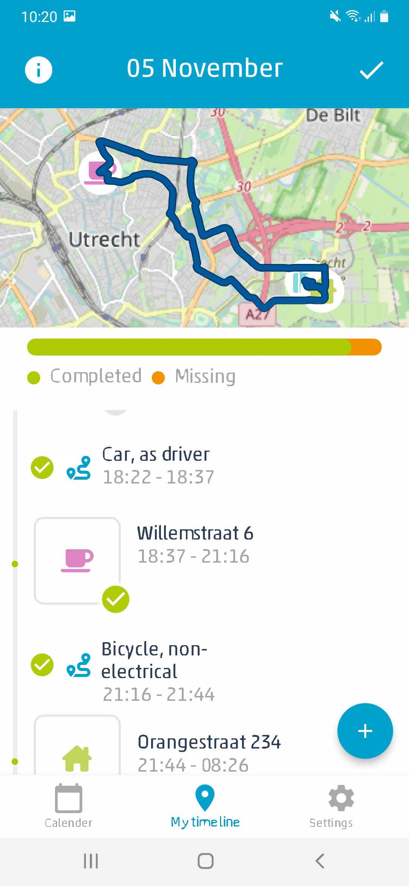
PhD Recruitment & Retention in Smart Surveys
Remmerswaal et al. (2025) Effects of Study Duration on Response, Representation and Data Quality in Travel Diary App Survey Research Methods (in press).
Experiment in invitation letter: 1 vs. 7 days
RR 1 day: 11%
RR 7 days: 14%
Notes:
RR 1 day assigned day: 11%
RR 7 days no assigned day: 14%
Effect of study duration is uncertain: maybe the assigned day (yes or no) has more impact

Slide 3
Invited to participate:
1 day
7 days
Notes:
Both groups are able to participate for the whole week.

Slide 4
How to determine the optimal number of diary days?
Benefits
Costs
Burden
Statistical value of extra days

Slide 5
How to determine the optimal number of diary days?
Benefits
Costs
Burden
Statistical value of extra days
Nonresponse
Time
Inter- and intra- individual variance
Reliability
Dropout
Notes:
Smart surveys promise lower burden
Q: does this alter the considerations and the decision on the reporting period?

Slide 6
How does the trade-off work out for Three Smart Diary Surveys?
Household Budget Study (HBS)
Travel Diary Study (TDS)
Physical Activity Study (PAS)

Slide 7
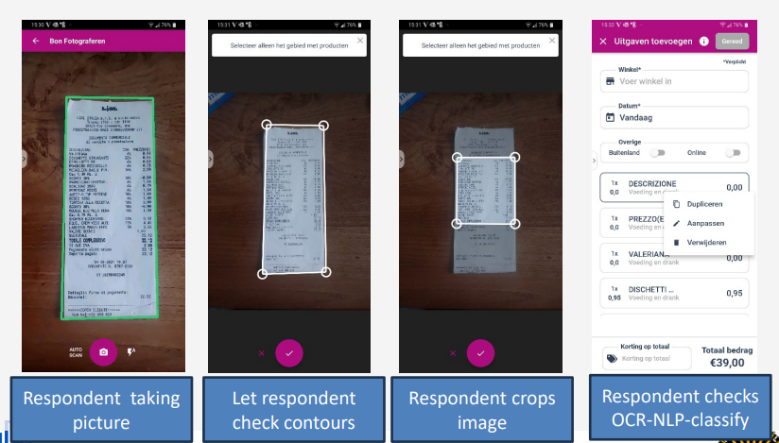
Smart study 1: Household Budget Survey (HBS)
OCR = Optical Character Recognition. NLP = Natural Language Processing

Slide 8
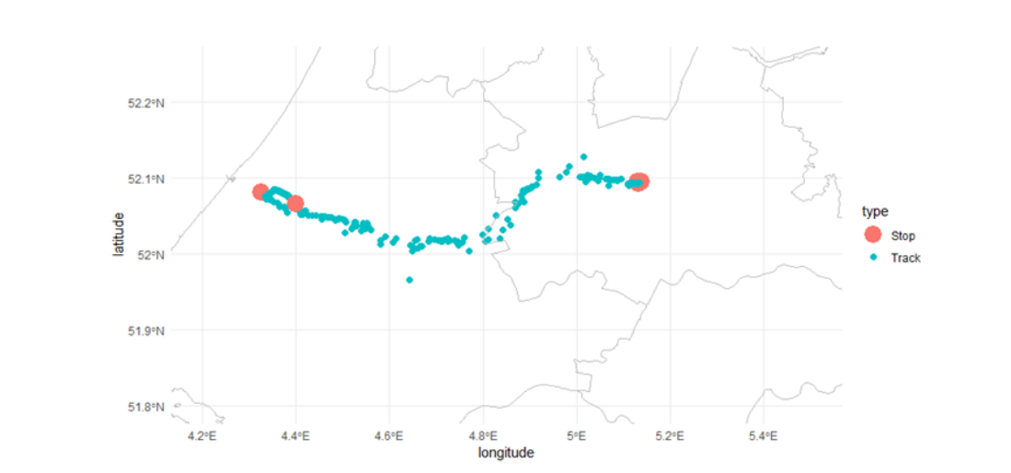
Smart survey 2: Travel Diary Survey (TDS)

Slide 9
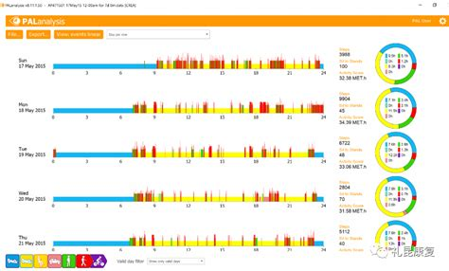
Smart survey 3: Physical Activity Study (PAS)

Slide 10
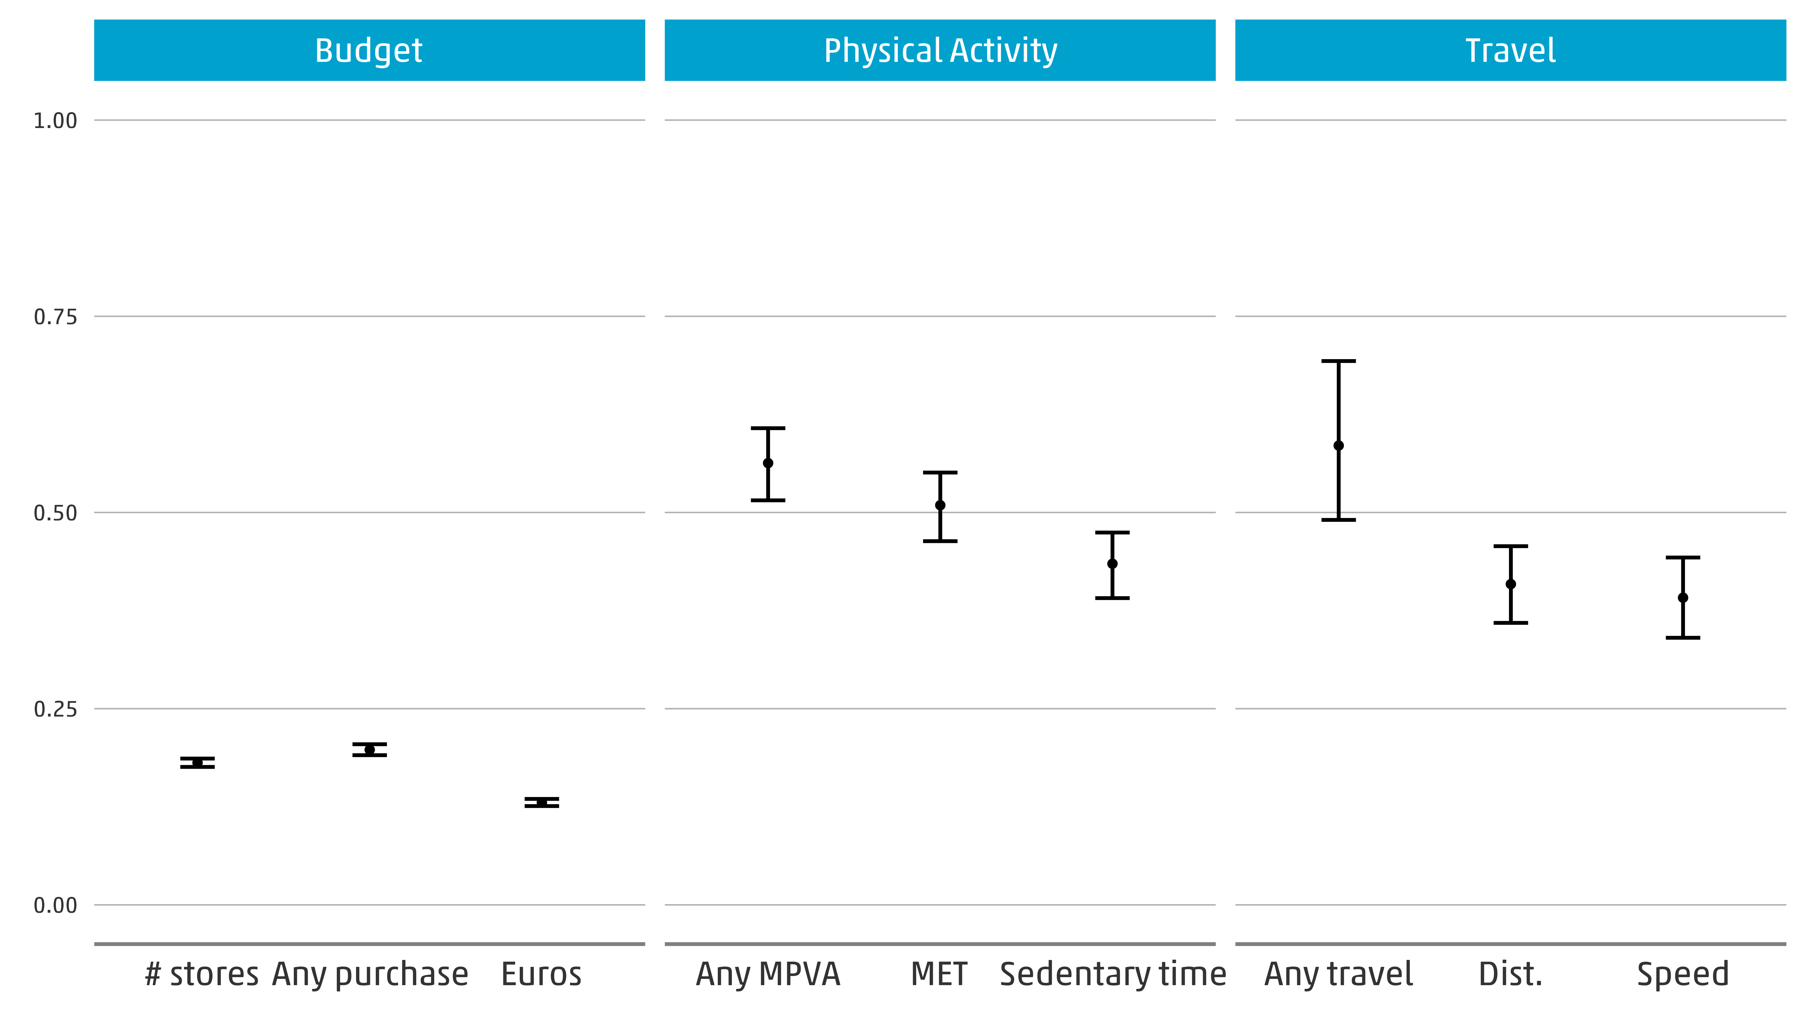
Results: ICCs
ICC = $\frac{σ_{B}^{2}}{σ_{B}^{2}+σ_{W}^{2}}$
Note: 95% confidence intervals are calculated using non-parametric cluster bootstrapping of the individuals
Notes:
Not everyday is the same. People have different budget/physical activity/travel behaviour on different days.
The higher the ICC, the more similar two days of the same respondent are.
Variables in the physical activity study and in the travel diary study have a higher ICC than the variables in the budget diary.

Slide 11
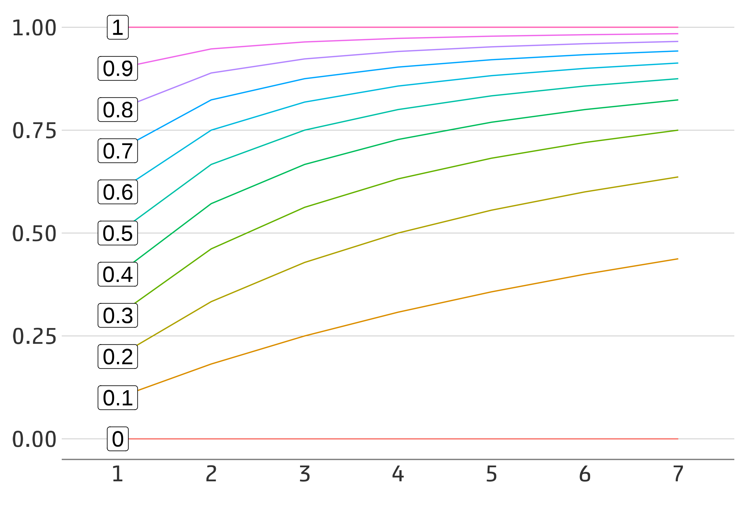
Results: Reliability
R_{D} = $\frac{σ_{B}^{2}}{σ_{B}^{2}+(\frac{σ_{W}^{2}}{D})}$

Slide 12
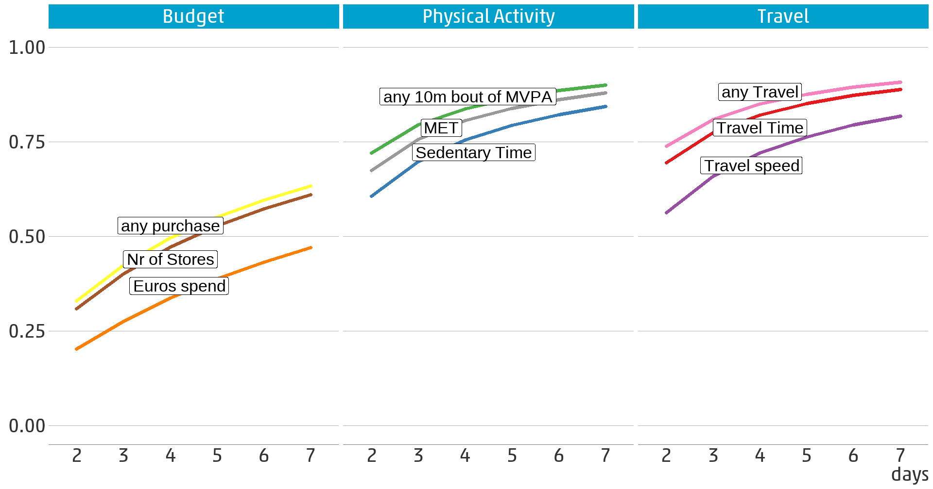
Results: Reliability
R_{D} = $\frac{σ_{B}^{2}}{σ_{B}^{2}+(\frac{σ_{W}^{2}}{D})}$
Notes:
HBS data (we use the regular web diary) has many more respondents (~10,000) so confidence intervals are smaller.
for inspected variables in HBS data, there is clearly more to learn after two weeks. Reliability of the variables is roughly .6 after 7 days
For the PAS (physical activity) data variables have a reliability of ~.9 after 7 days
For the travel (TDS) data variables have a reliability of ~.85 after 7 days

Slide 13
Design effect and sample size reduction
Variance Reduction = $\frac{\text{s}\text{.}\text{e}\text{. (}\text{Y}\text{id}\text{)}}{\text{s}\text{.}\text{e}\text{. (}\text{Y}\text{i}\text{1}\text{)}}$ = $\frac{\text{N}\text{d}}{\text{N}\text{1}}=\frac{1+\left(D−1\right)ICC}{\text{D}}$
s.e. (Y_{i} ) = standard error of Y
N_{d} = sample size of d day diary
N₁ = sample size of 1 day diary
D = days
ICC = intraclass correlation coefficient
Pas, E. I. (1986). Multiday Samples, Parameter Estimation Precision, and Data Collection Costs for Least Squares Regression Trip-Generation Models. Environment and Planning A: Economy and Space, 18(1), 73-87. https://doi.org/10.1068/a180073

Slide 14
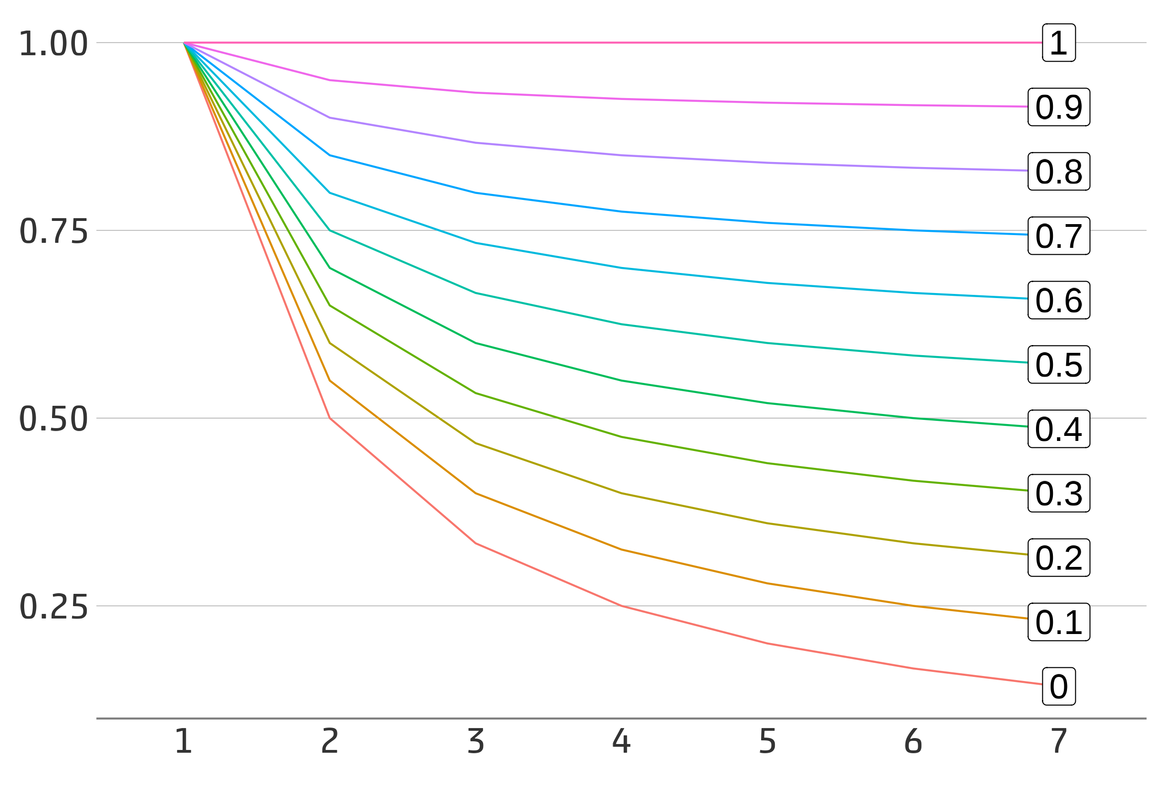
Results: Sample Size Reduction
$\frac{\text{N}\text{d}}{\text{N}\text{1}}=\frac{1+\left(D−1\right)ICC}{\text{D}}$

Slide 15
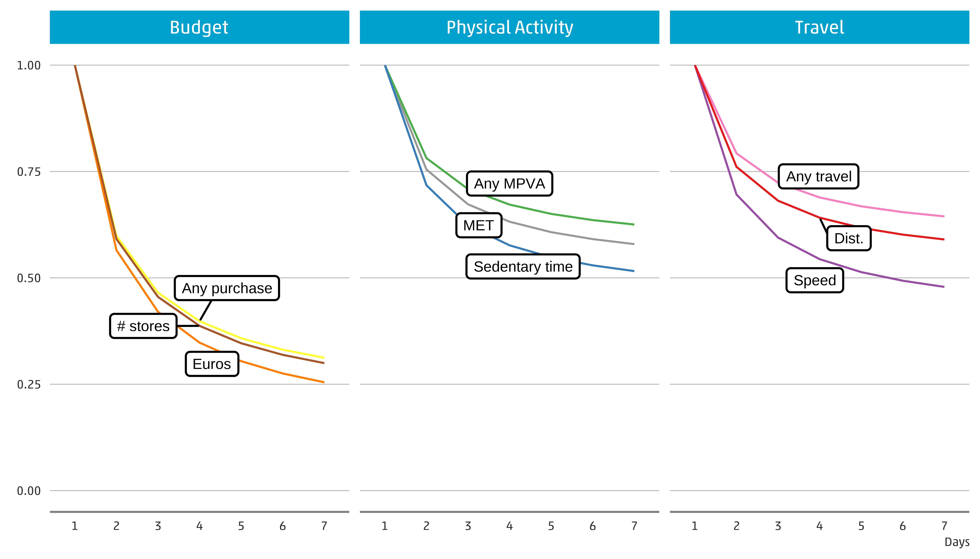
Results: Sample Size Reduction
$\frac{\text{N}\text{d}}{\text{N}\text{1}}=\frac{1+\left(D−1\right)ICC}{\text{D}}$
Notes:
Data of a one-day diary study in the physical activity study has the same precision as a 7 diary days study with 50% of the participants

Slide 16
Discussion
Benefits
Costs
Burden
Statistical value of extra days
Nonresponse
Time
Inter- and intra- individual variance
Reliability
Dropout

Slide 17
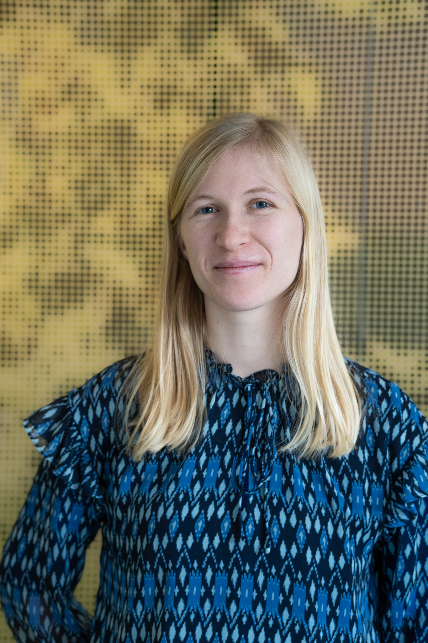
Thank you!
QR code to LinkedIn Profile
Contact me via email!
d.m.remmerswaal@uu.nl
Daniëlle Remmerswaal
PhD candidate Survey Methodology,
Utrecht University &
Statistics Netherlands

