Slide 1
Say Cheese! A Case Study on
how Measurement Error in Smart Surveys affects Text Classification.
Chris Lam, Marco Puts
June 4-5, 2026, Barcelona

Slide 2
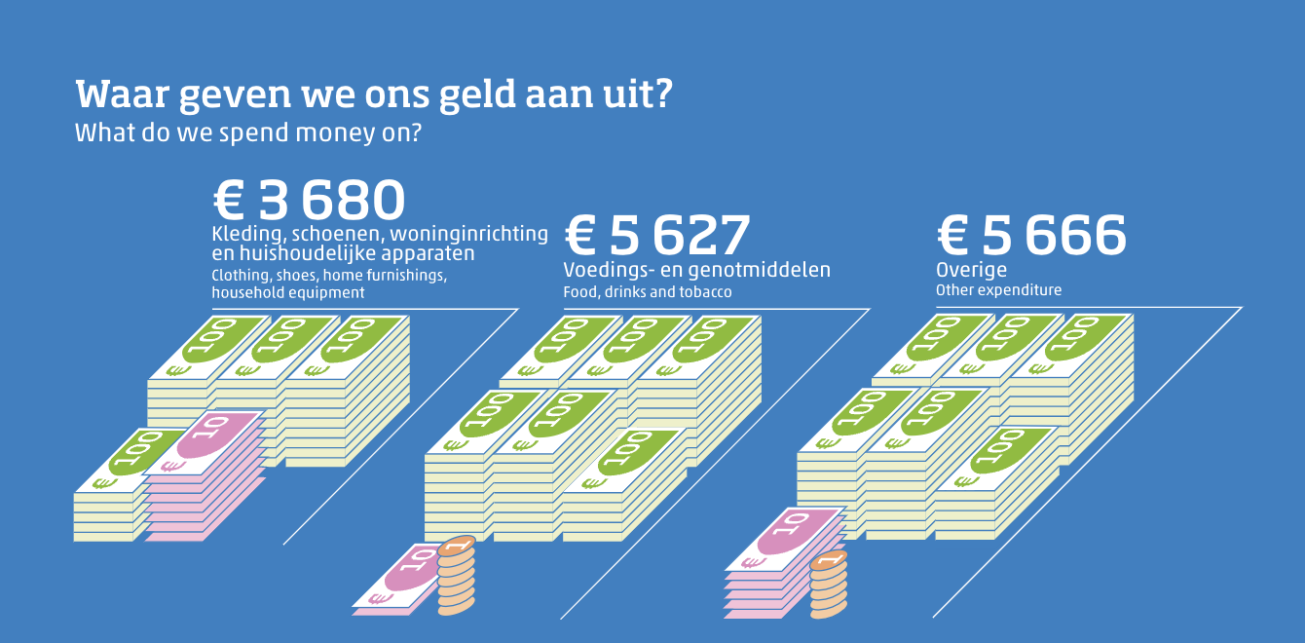
Introduction: smart survey case study
The Household Budget Survey

Slide 3

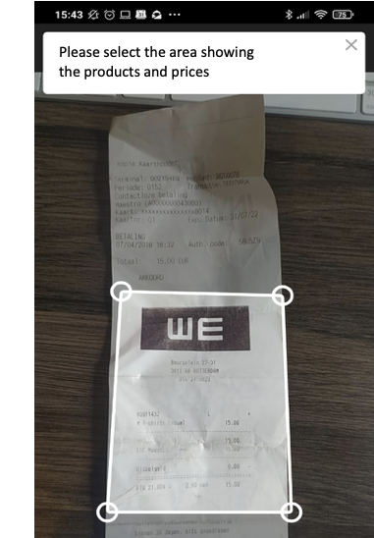
Smart Surveys: A Case Study
The Household Budget Survey

Slide 4
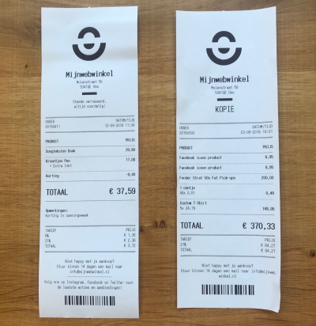
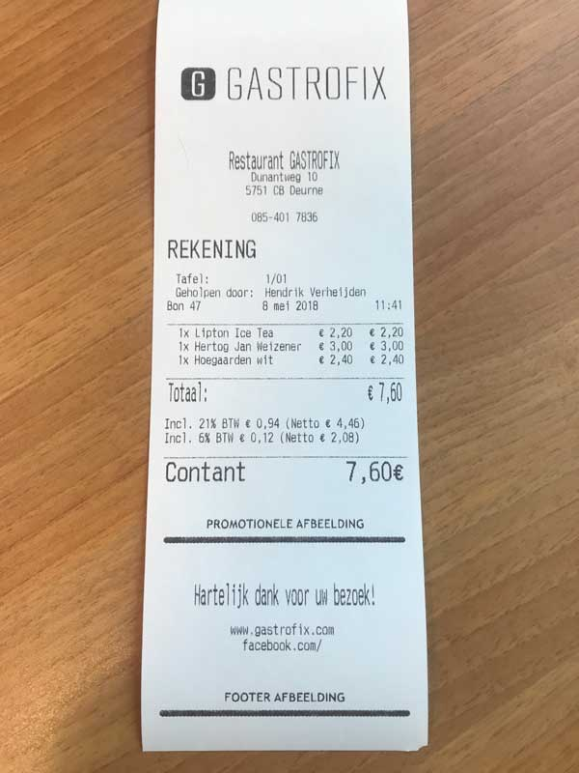
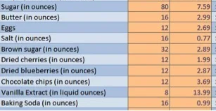
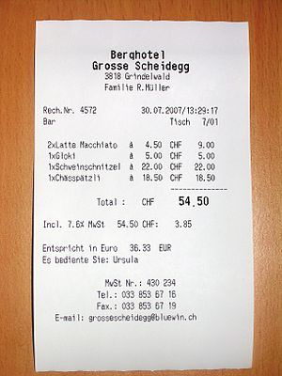
Needs to be processed into usable data

Slide 5
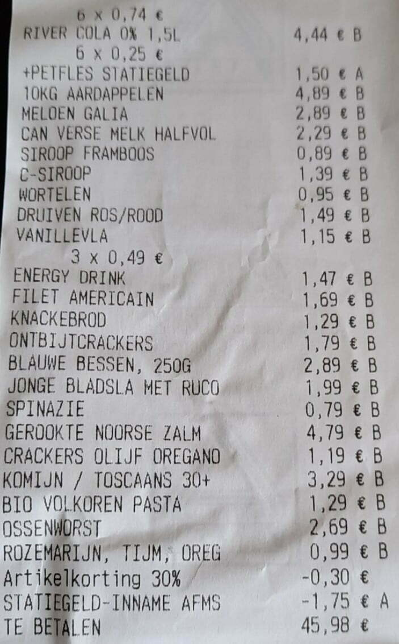
Processing steps: from Receipts to Data
Data Capture

Slide 6
Processing steps: from Receipts to Data
Data Capture
Product description | Price
river cola 0% | 4.44
aardappelen | 1.5
… | …
The text is formatted, and the products are recognized

Slide 7
Processing steps: from Receipts to Data
Data Capture
Product classification
Product description
river cola 0%
aardappelen
…

Slide 8
Processing steps: from Receipts to Data
Data Capture
Product classification
Product description | Product category
river cola 0% | 12112
10kg aardappelen | 11524
… | …

Slide 9
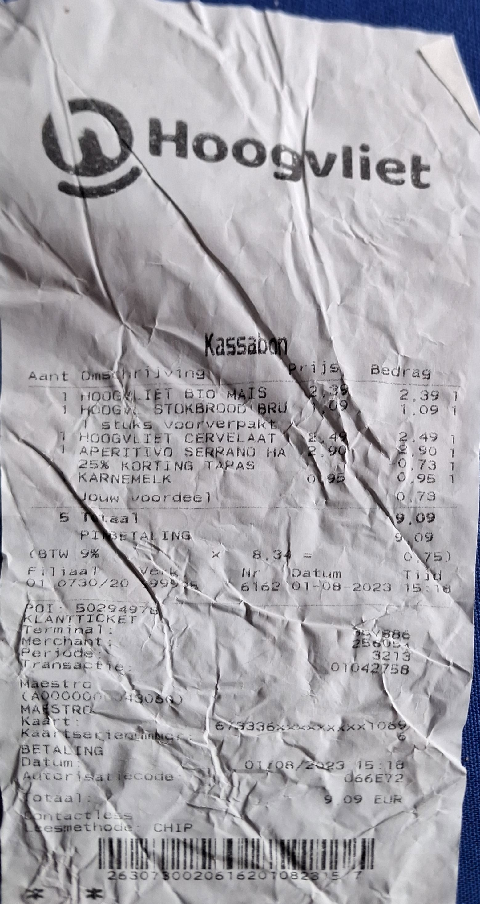
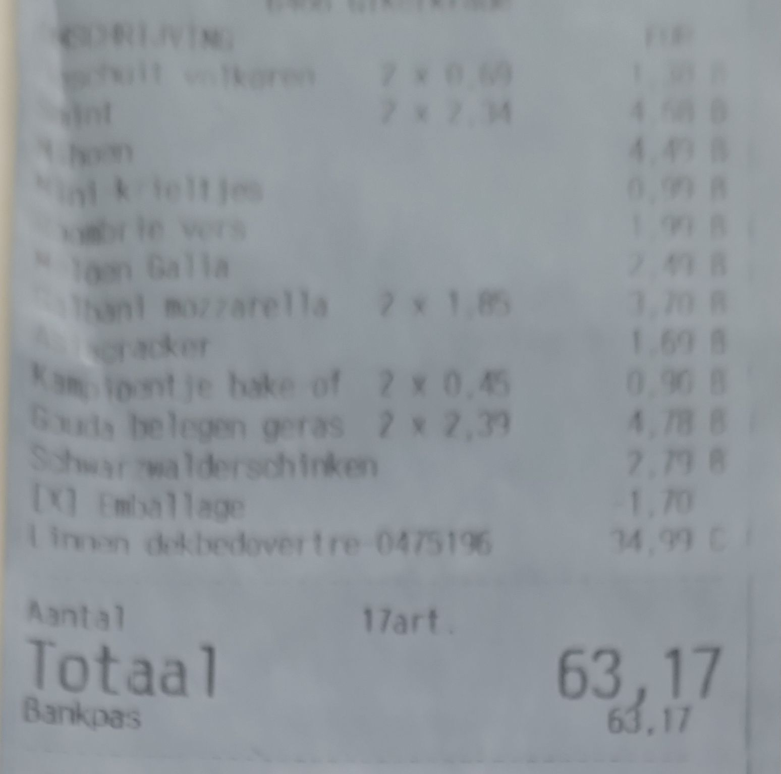
Introduction: Smart Surveys for Scanning
Measurement error in scanning…

Slide 10
Introduction: Smart Surveys for Scanning
Data collection
Data capture
Coding
…
C0c co14
Apple
co kies
???
???
???
Will definitely lead to misclassifications

Slide 11
Introduction: Smart Surveys for Scanning
Data collection
Data capture
Coding
…
C0c co14
Apple
co kies
???
???
???
How much measurement error is there?
How does the measurement error affect the individual coding?

Slide 12
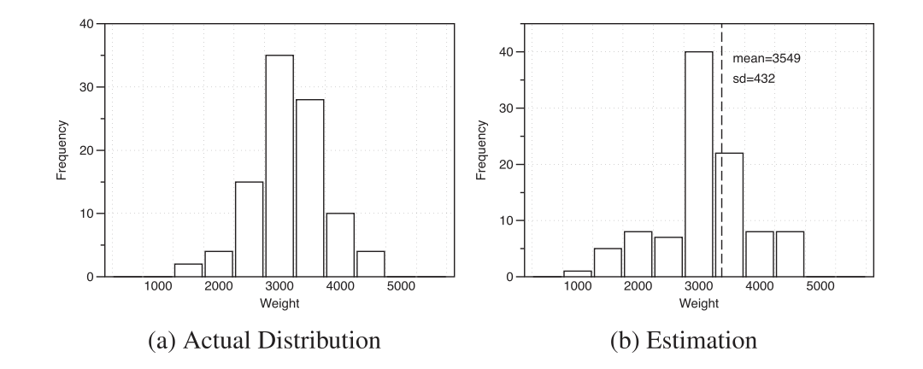
Introduction: Effect on Class Distribution
To what extent does this affect the class distribution?
From Gonzalez et al. (2017)

Slide 13
Introduction: research question and data
Research questions
How to quantify measurement error in document images.
How does measurement error affect the coding quality?
How does measurement error affect the class distribution?
Case study: Data
169 photos of receipts from a test of a smartphone application

Slide 14
Measuring Measurement Error

Slide 15
Measuring Measurement Error
How to measure?
  Measure the Optical Character Recognition
  (OCR) quality (Alaei et al., 2023)
  String similarity (e.g. Levenshtein similarity)
  Different OCR Models must be tested
OCR Model
f1sk
Levenshtein similarity: 0.5
Fish
Notes:
Measurement error can be measured by measuring the OCR quality
But since the OCR quality is depend on the performance of the OCR model, different OCR models must be tested

Slide 16
Measuring string similarity
OCR Model
(Tesseract)
Product Texts
(Tesseract)
String similarities
Annotated Product Texts
Human annotator

Slide 17
Measuring string similarity
OCR Model
(Tesseract)
Product Texts
(Tesseract)
String similarities
Annotated Product Texts
Human annotator
String similarities
OCR Model
(PaddleOCR)
Product Texts
(PaddleOCR)

Slide 18
Measuring string similarity
OCR Model
(Tesseract)
Product Texts
(Tesseract)
String similarities
Annotated Product Texts
Human annotator
String similarities
OCR Model
(PaddleOCR)
Product Texts
(PaddleOCR)

Slide 19
Results: OCR Texts vs Manually Annotated
A significant difference in OCR quality between the two OCR methods (p << 0.001)

Slide 20
Varying Measurement error on Coding

Slide 21
Effect on the coding quality
Product Texts
(Tesseract)
Machine Learning Classifier
Coded items
Accuracy score
Manually Annotated Product Texts
Coded items
Accuracy score
Product Texts
(PaddleOCR)
Coded items

Slide 22
Results: How OCR quality affects Coding
Again a significant difference between the two OCR methods (p << 0.001)

Slide 23
Measurement error on the class distribution

Slide 24
Effect on the coding quality
Product Texts
(Tesseract)
Machine Learning Classifier
Coded items
Manually Annotated Product Texts
Coded items
Product Texts
(PaddleOCR)
Coded items

Slide 25
Effect on the coding quality
Product Texts
(Tesseract)
Machine Learning Classifier
Coded items
Contingency matrix
Manually Annotated Product Texts
Coded items
Contingency
matrix
Product Texts
(PaddleOCR)
Coded items

Slide 26
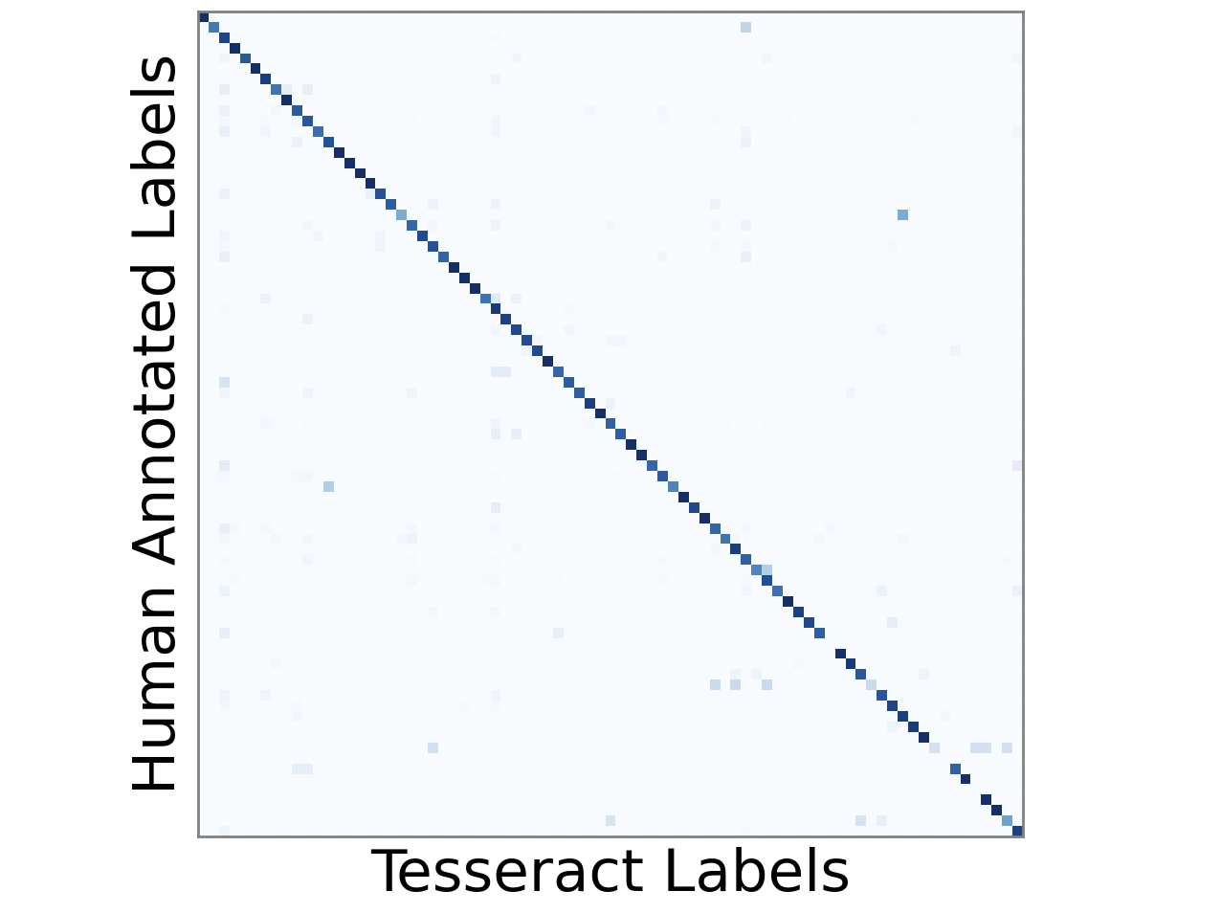
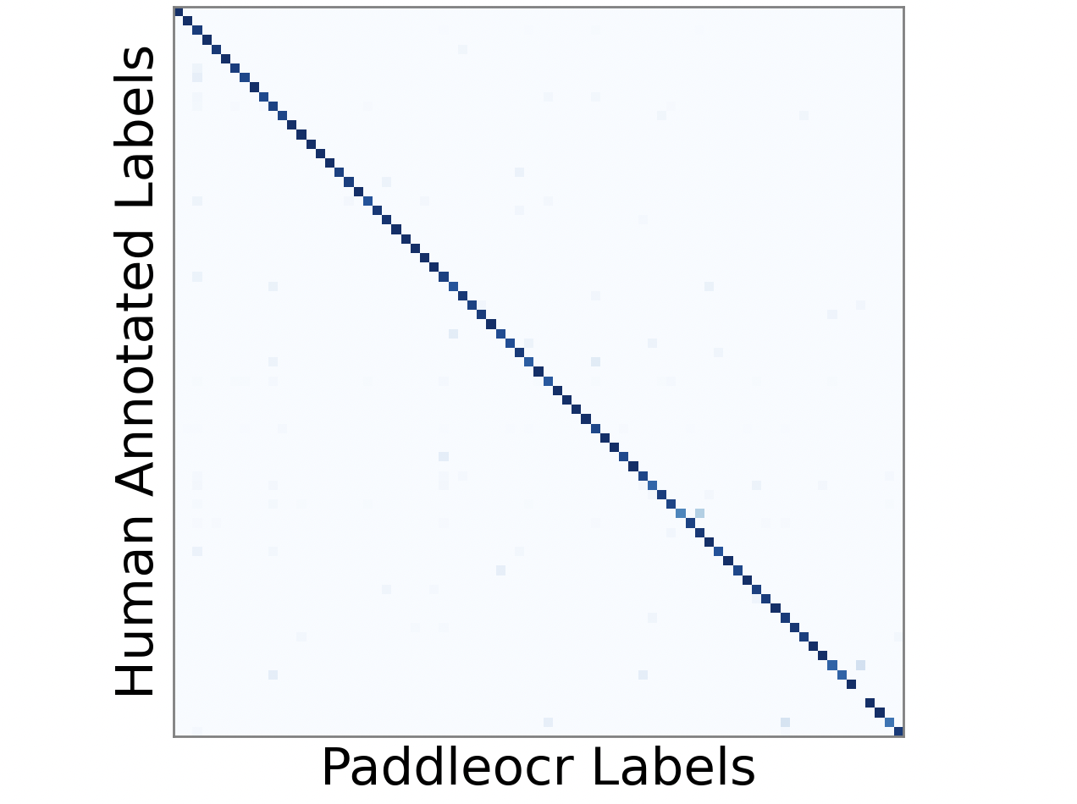
Class distribution vs “ground truth labels”
Contingency matrices
Labels OCR Models vs Labels Annotated Texts

Slide 27
Class distribution vs “ground truth labels”
Using the McNemar-Bowkers test, no evidence of signficant differences could be found on either contingency matrices!
Contingency matrices
Labels OCR Models vs Labels Annotated Texts

Slide 28
Class distribution vs “ground truth labels”
To show differences between the OCR models:
Contingency matrices (Log scale)

Slide 29
Conclusion

Slide 30
Conclusion
In this use case: despite significant differences in measurement error (OCR quality between methods) and subsequently in the coding accuracy,
no significant difference could be found in the class distributions.
To what extent does optimizing OCR accuracy benefit the coding error?

